Slide 1

Cloud
STORGE

Slide 2

Table of
CONTENTS
01
02
03
04
Introduction
How is this helpful?
Briefly describe the concept
Nextcloud
05
06
07
08
Features
iInstallation
Limitations
Building own cloud

Slide 3

INTRODUCTION
Data storage where digital data is stored in logical pools.
The data is physically stored on multiple servers.
Accessible through the internet.

Slide 4

How is this
Scalability
Accessibility
Cost-effectiveness
Security
Real-time collaboration and file sharing
Helpful?

Slide 5
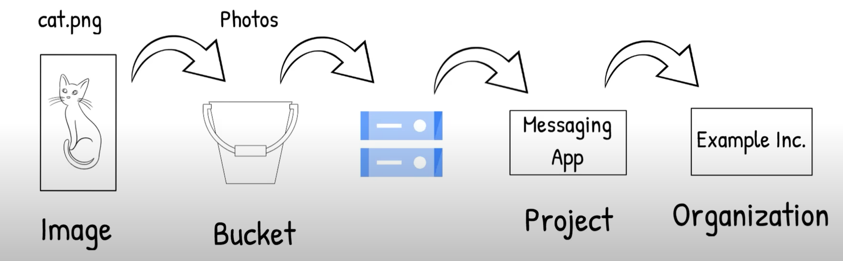
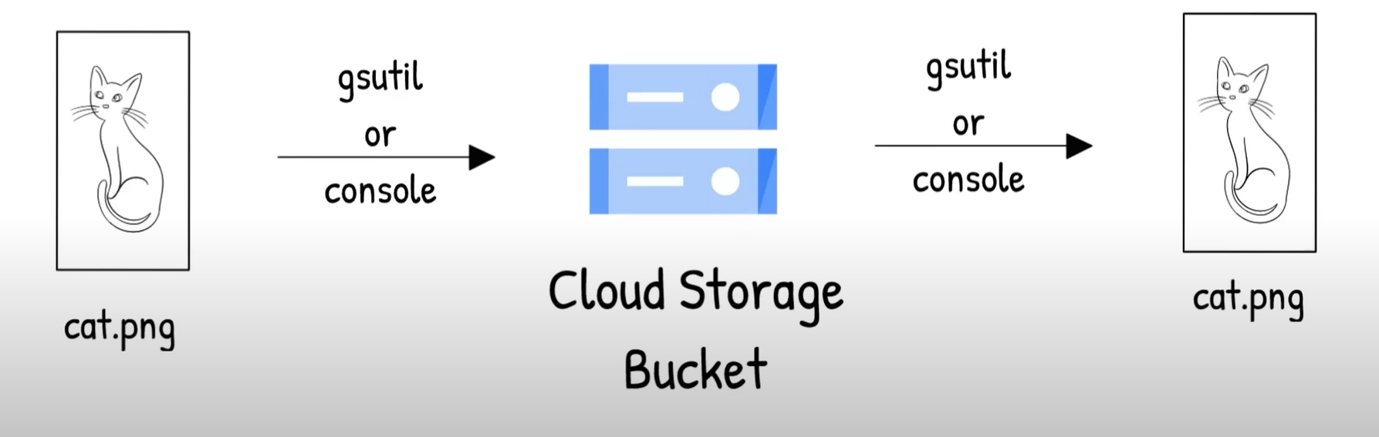

Slide 6

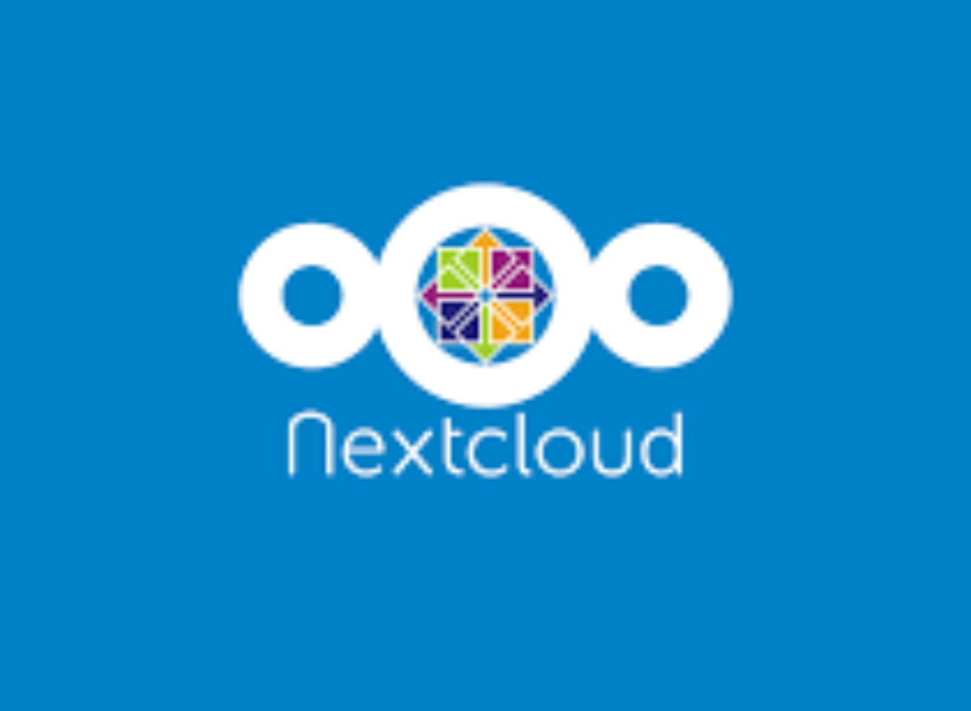
NEXTCLOUD
A popular, open-source file sharing and collaboration platform
It's a private cloud solution that provides a secure, flexible, and customizable way to manage data.

Slide 7
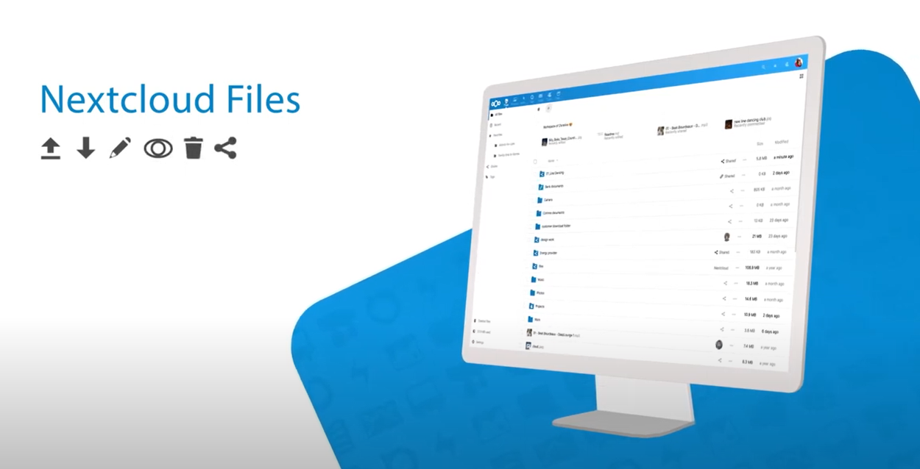
File synchronization
Sharing
Document collaboration
Calendar
Contact management
Video conferencing
FEATURES OF
NEXTCLOUD

Slide 8
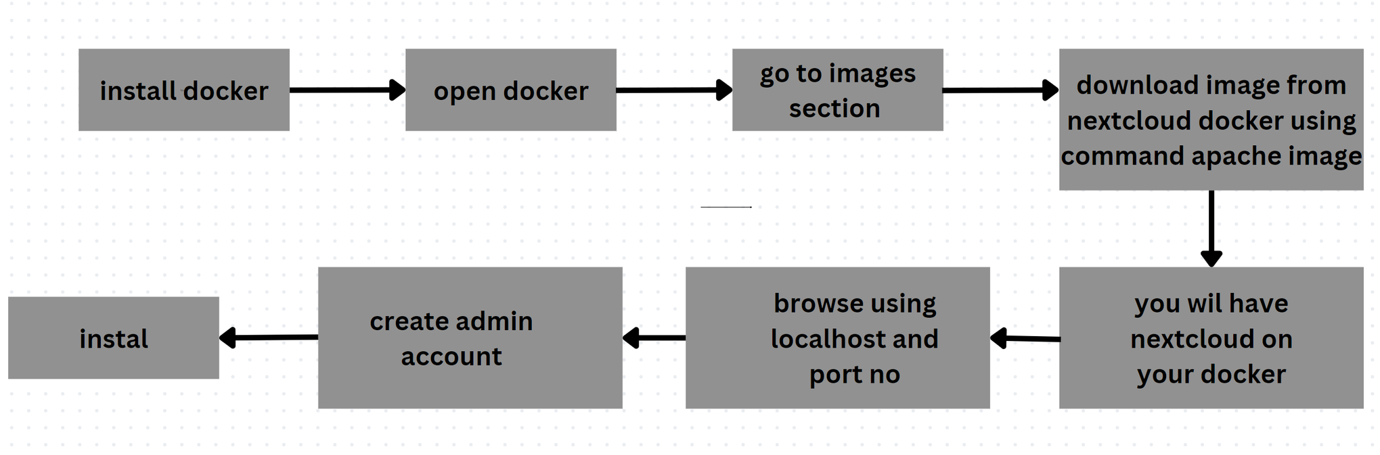

Slide 9
complexity
resource intensive
limited scalability
Limited Support for Large Files
Limited Mobile App Functionality
limitations

Slide 10
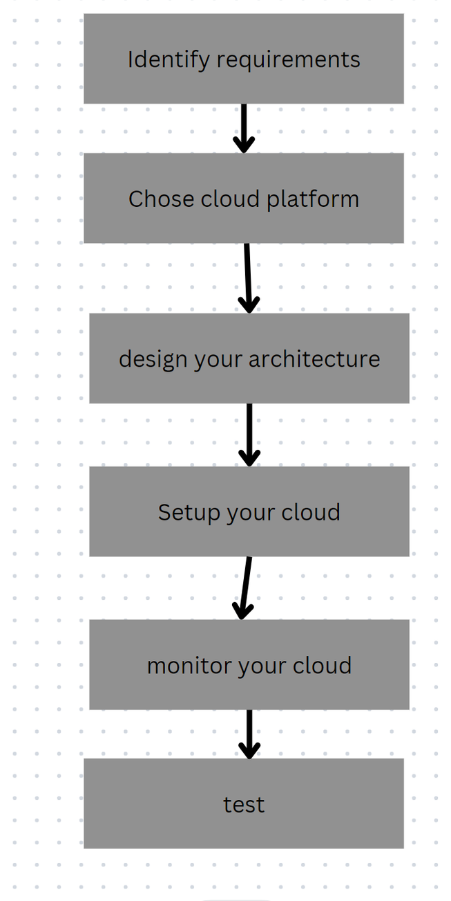
STEPS TO
FOLLOW

Slide 11
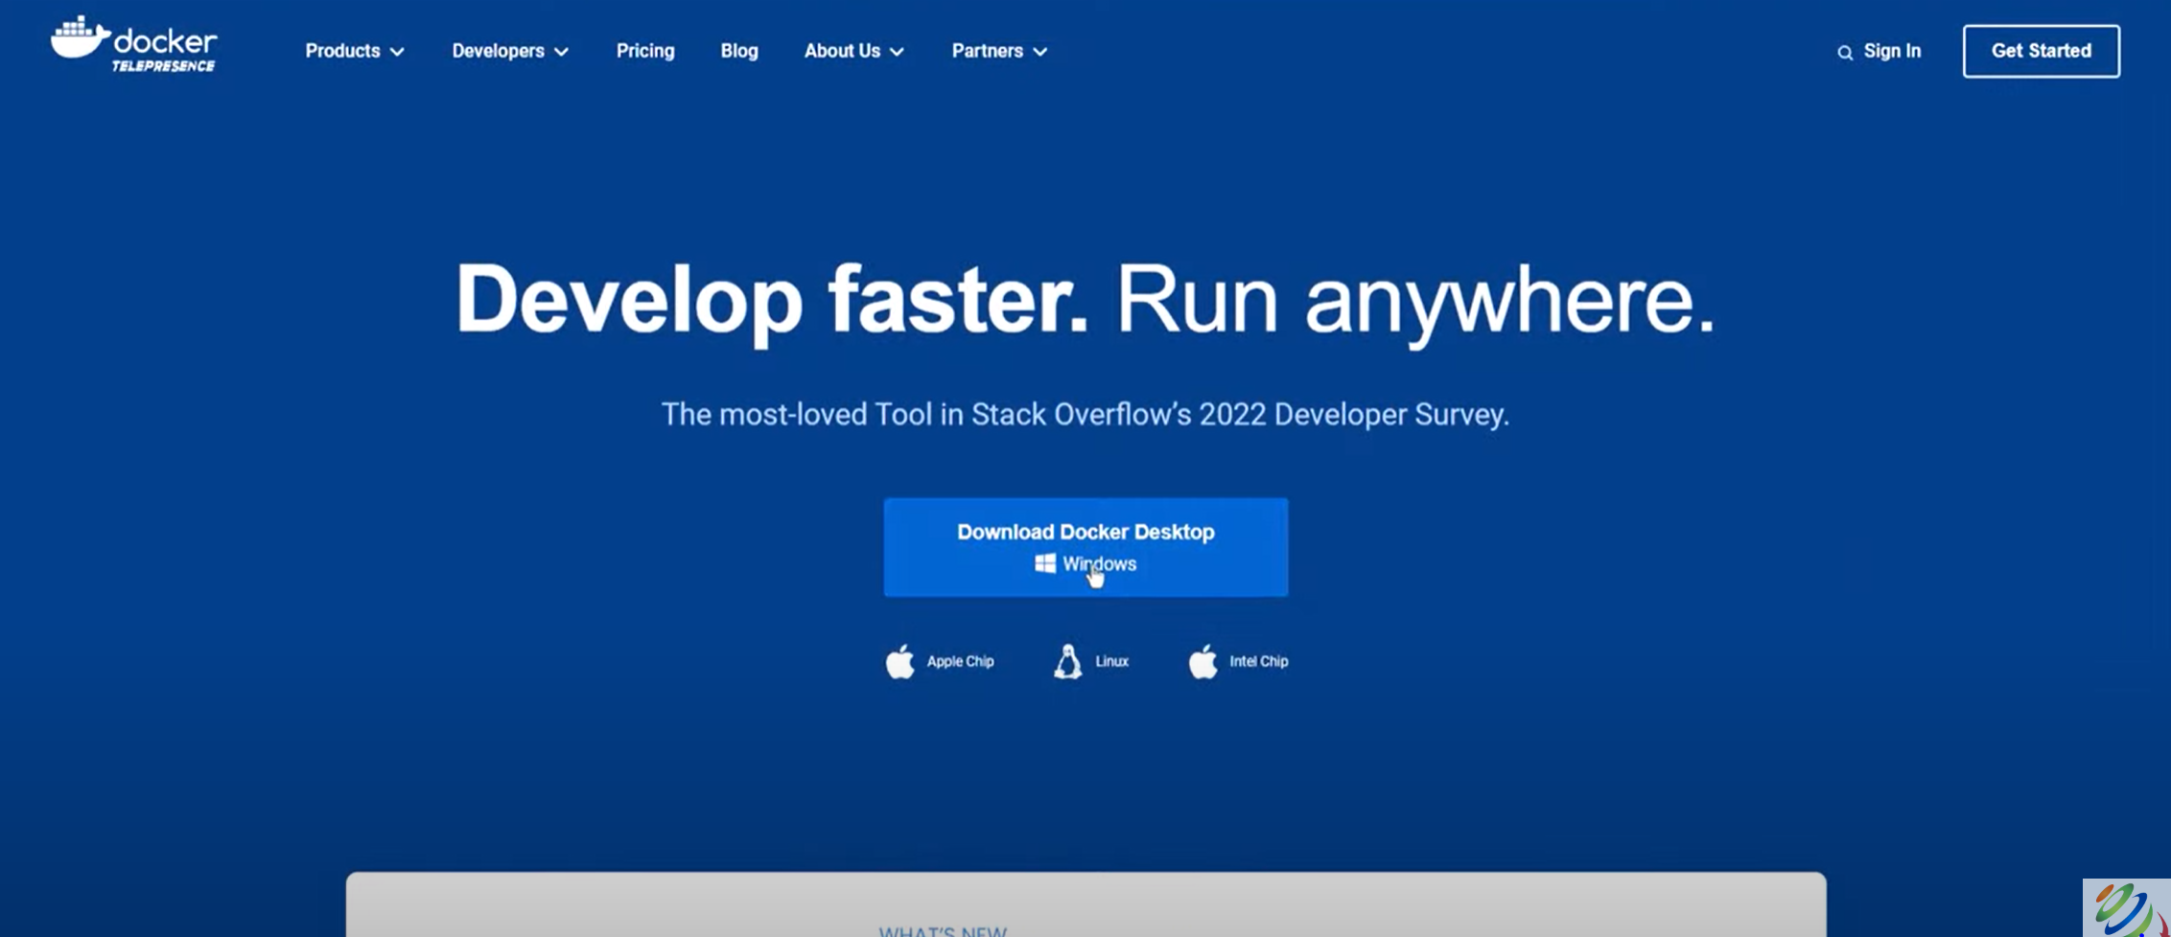

Slide 12
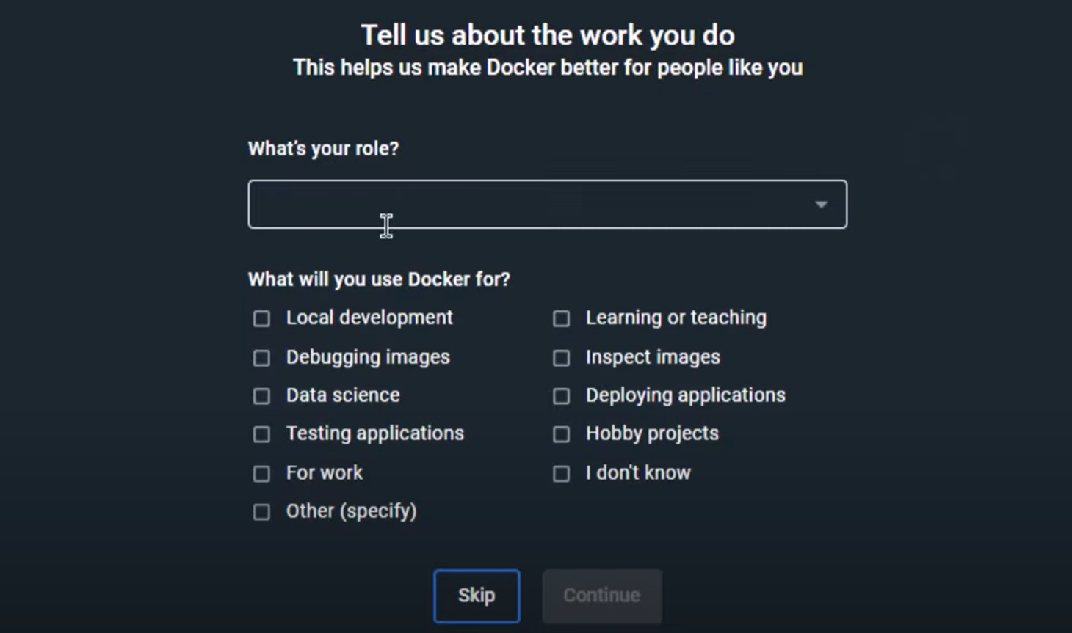

Slide 13
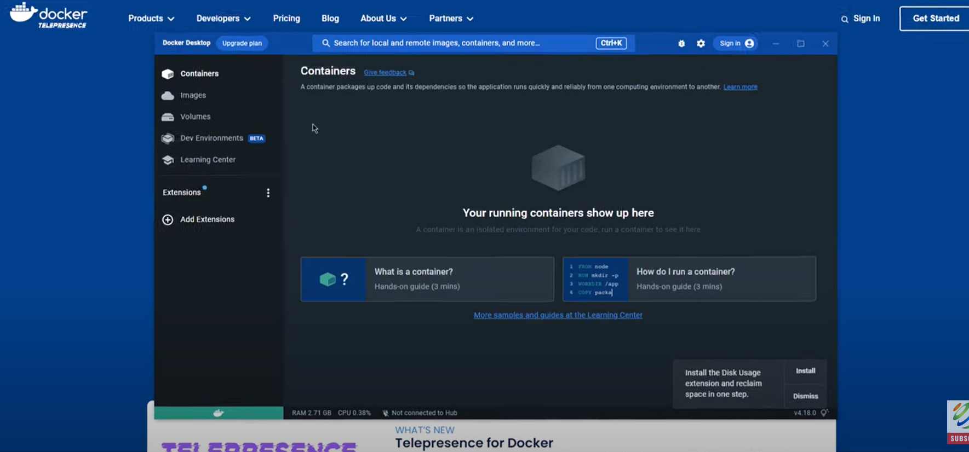

Slide 14
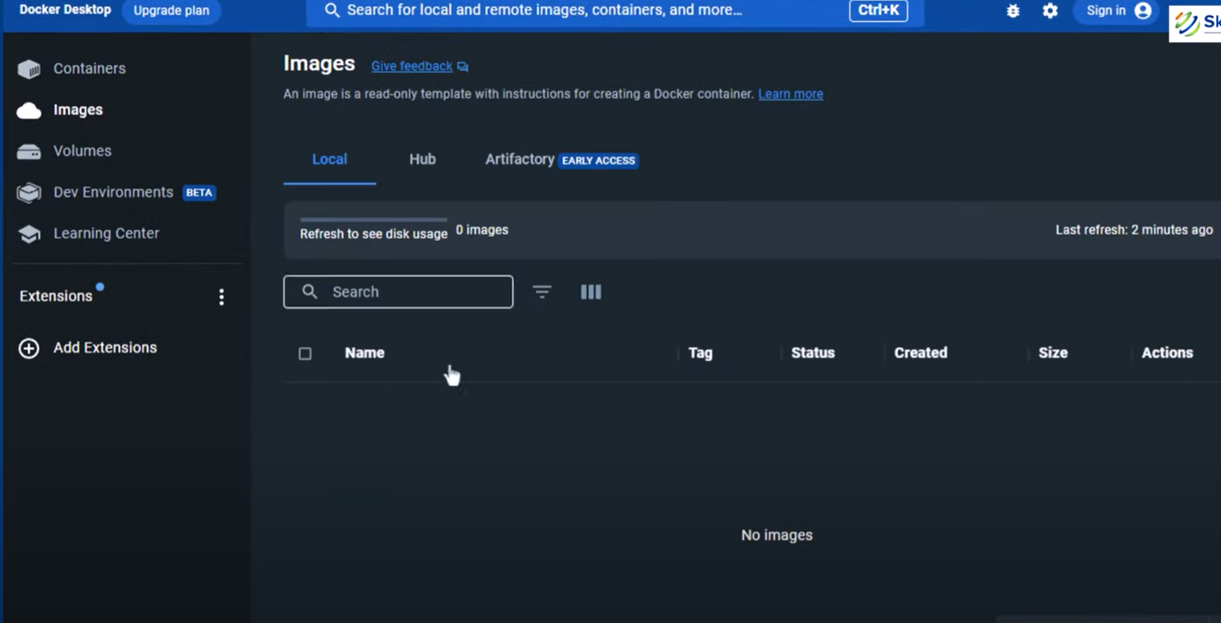

Slide 15
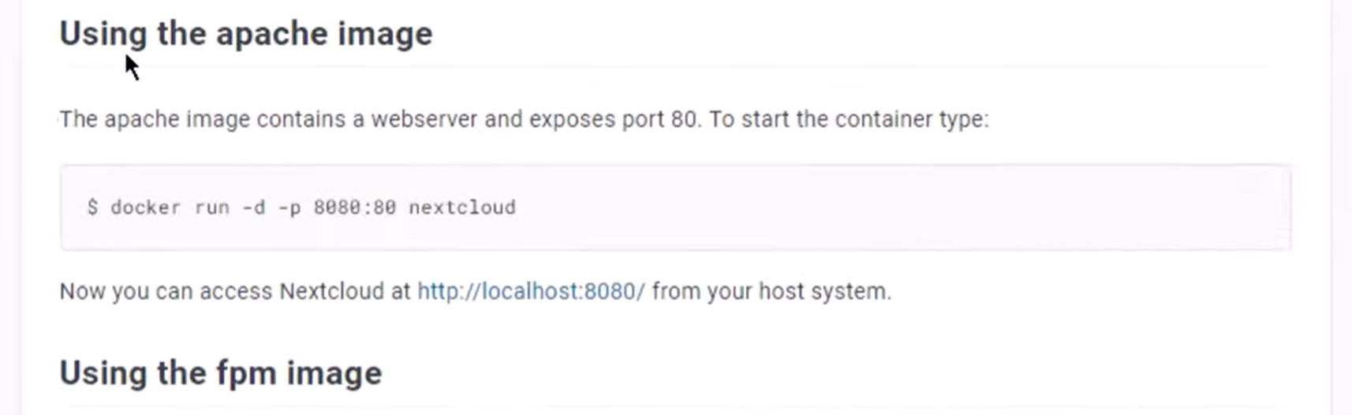
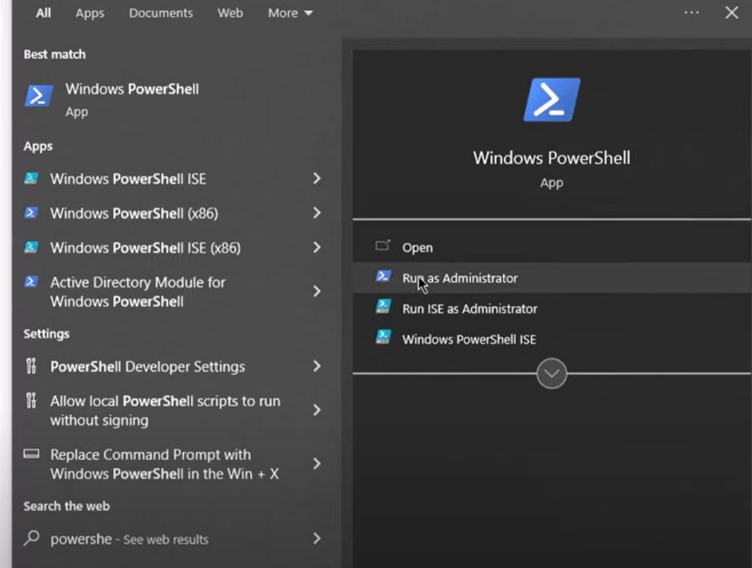

Slide 16
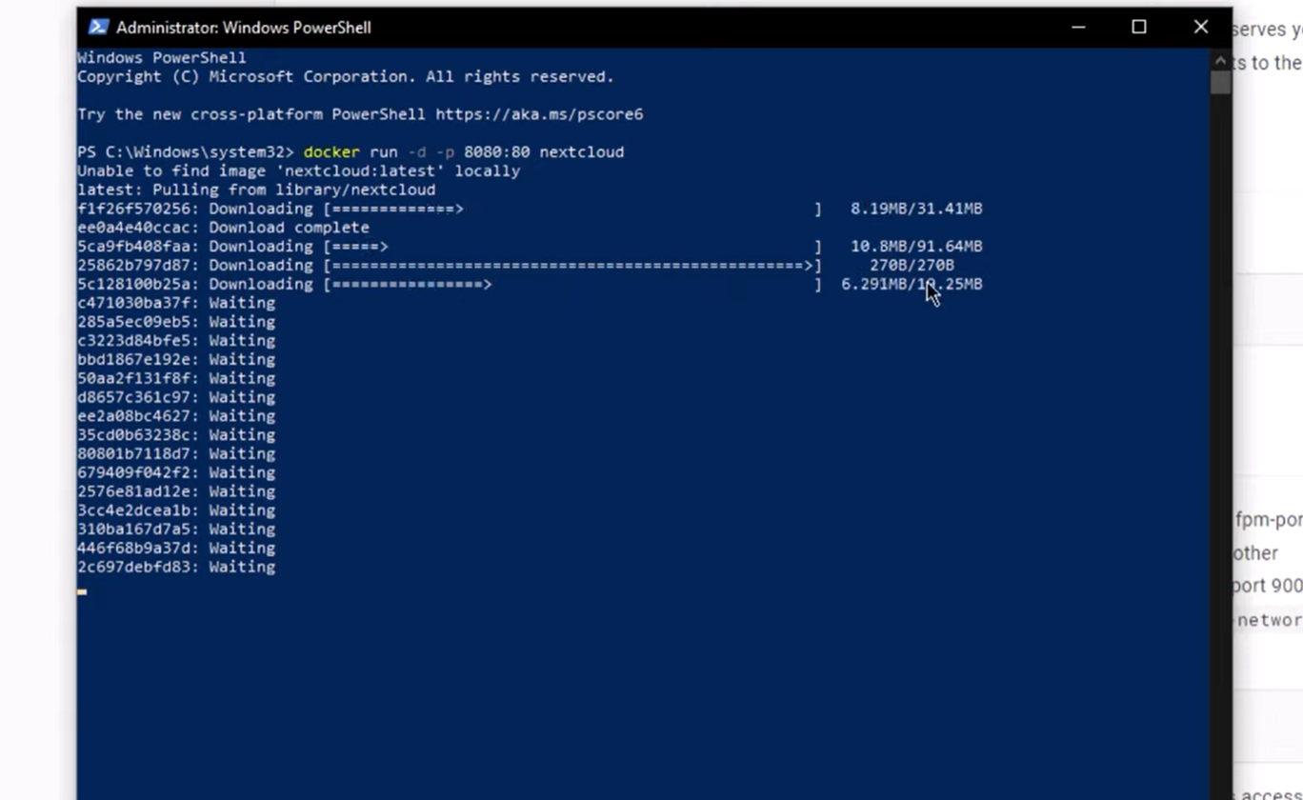

Slide 17
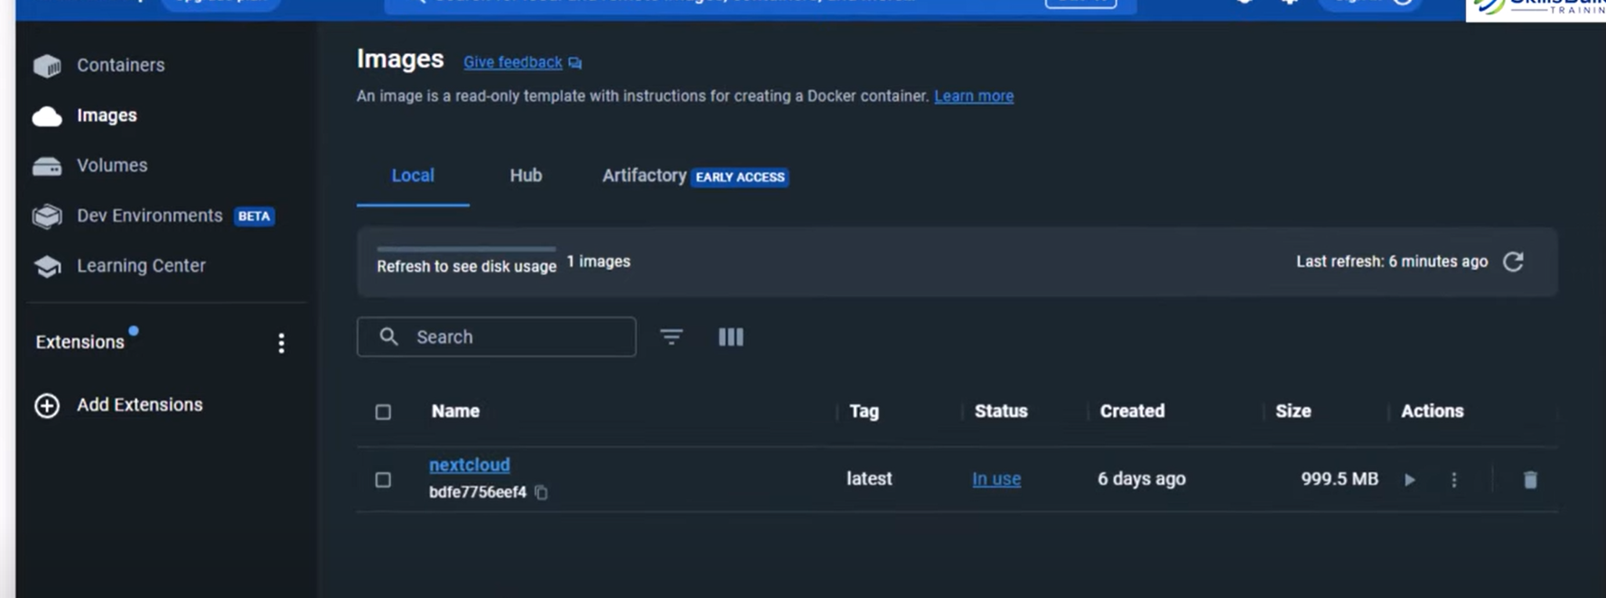
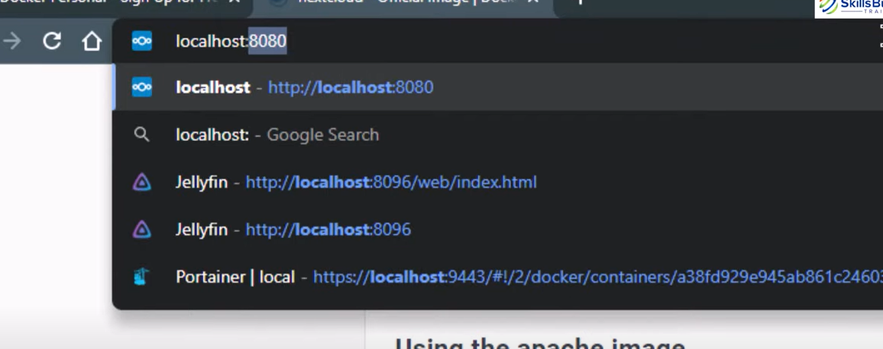

Slide 18
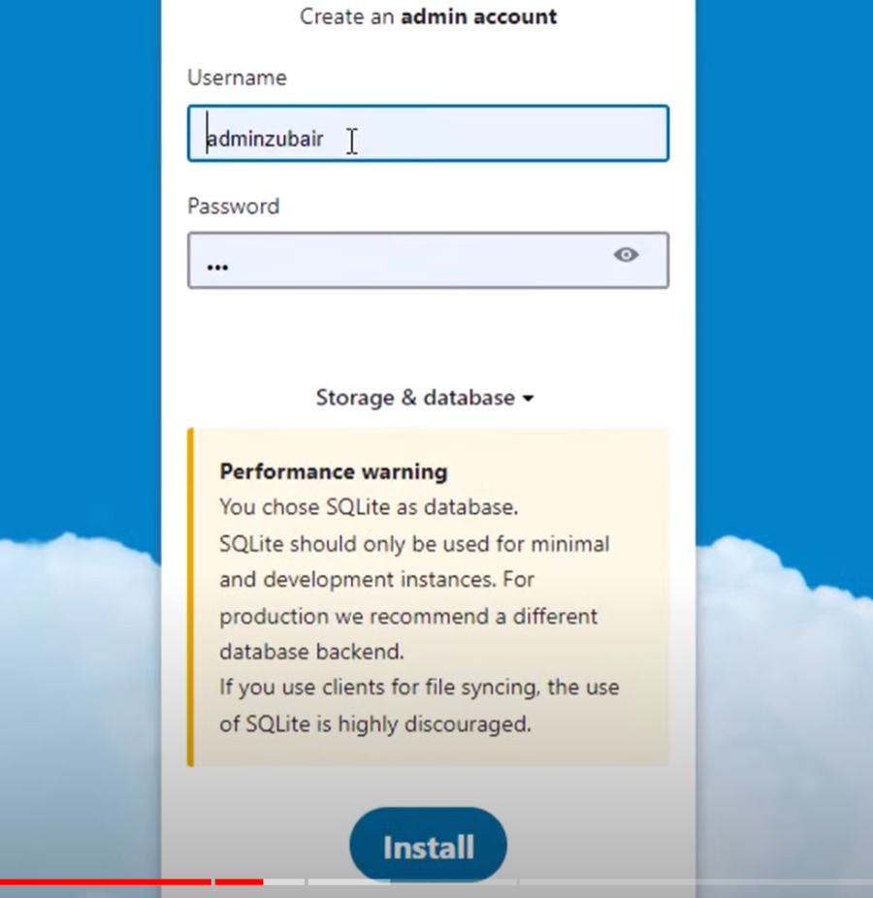
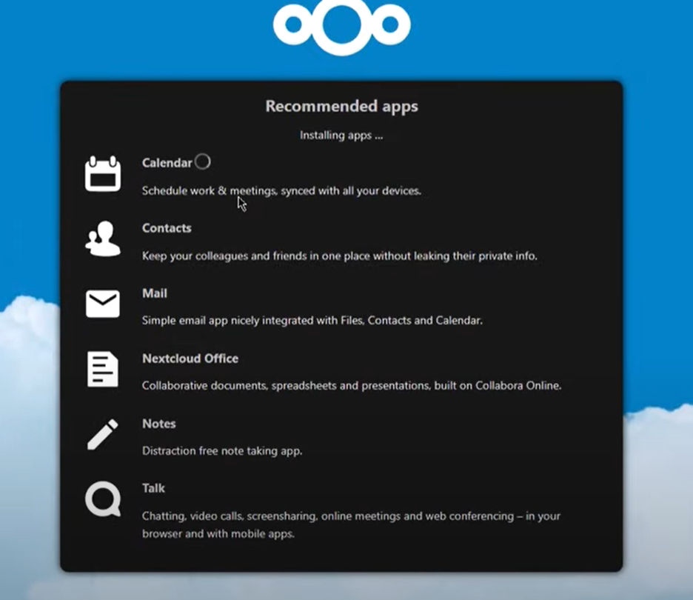

Slide 19
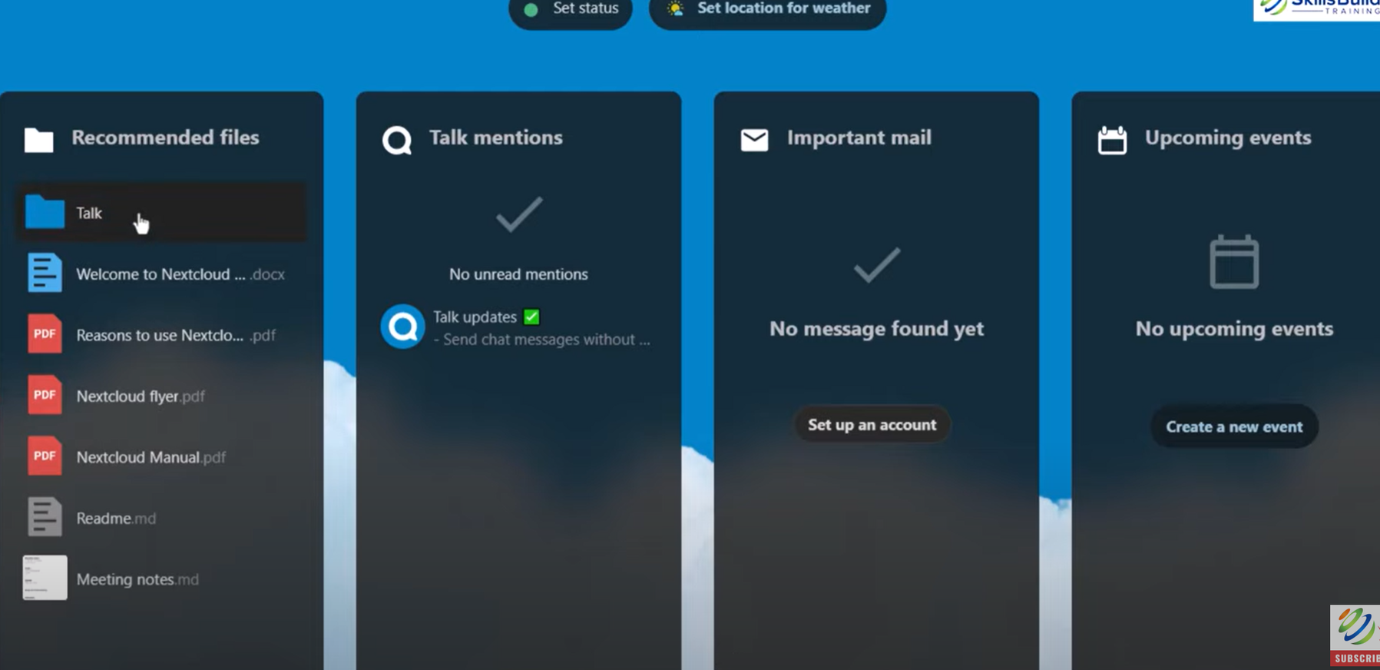

Slide 20
